Slide 1
Determining Efficacy of Regional Greenhouse Gasses Initiative
Charles Leung

Slide 2
Greenhouse Gasses
CO2 comprises about 80.9% of all greenhouse gasses
Greenhouse gasses trap radiative heat within the earth
Many initiatives to reduce our greenhouse gas emissions

Slide 3
Regional Greenhouse Gasses Initiative
10 States in the Northeast & Midatlantic
Cap and trade market based approach
Proceeds will be used to invest in green technology

Slide 4
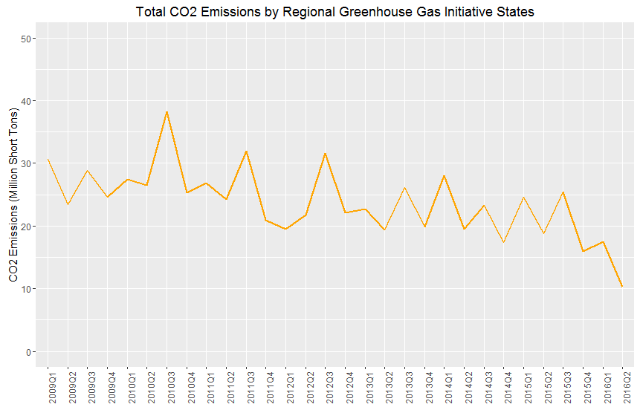

Slide 5
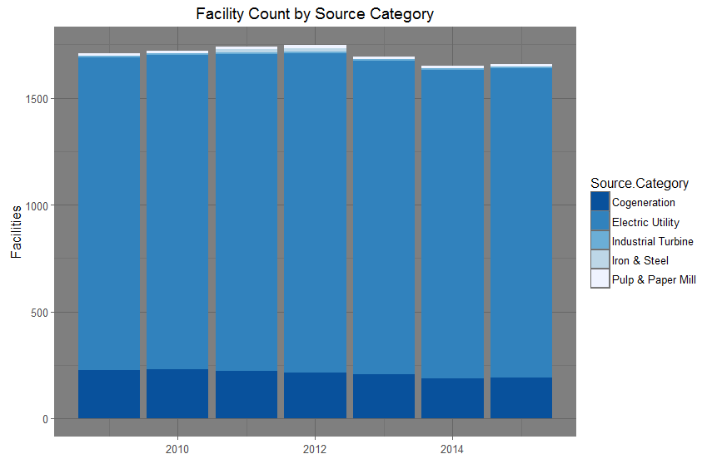

Slide 6
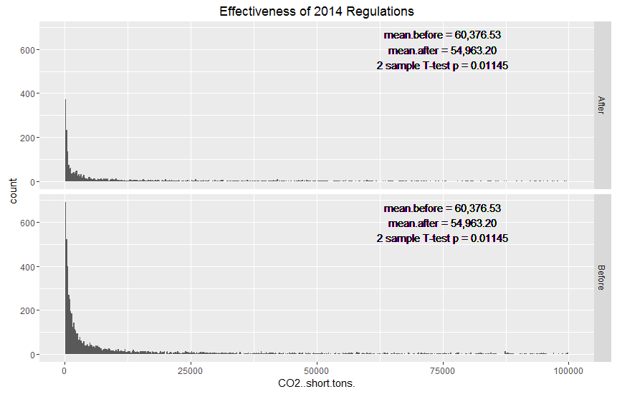

Slide 7
